Slide 1
Matplotlib

Slide 2
Overview
matplotlib - one of the most common data visualization packages in Python
matplotlib is used to create static, dynamic, and interactive plots
Figures can be created using pyplot – a library within matplotlib package

Slide 3
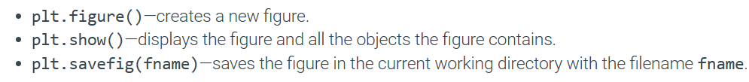
Plotting with matplotlib
pip install matplotlib
import matplotlib.pyplot as plt

Slide 4
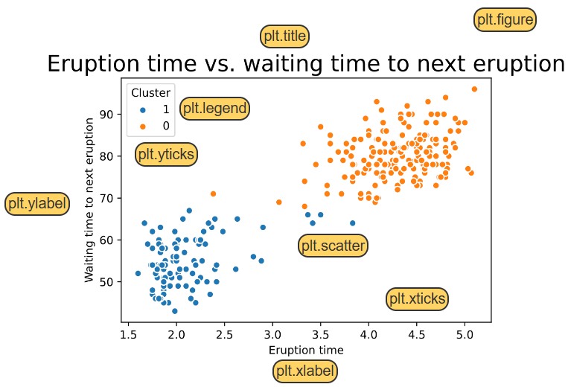

Slide 5
Creating plots
import matplotlib.pyplot as plt plt.plot()
plt.show()
Labeling plots
To add a title to a figure, the plt.title() function is used
The following functions are used to add text for the axes:
plt.xlabel(): adds text for the x-axis
plt.ylabel(): adds text for the y-axis

Slide 6
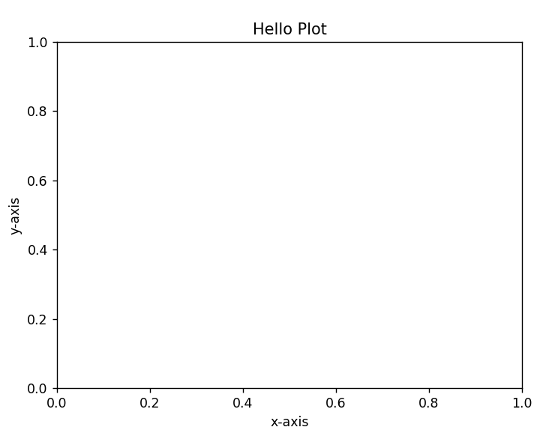
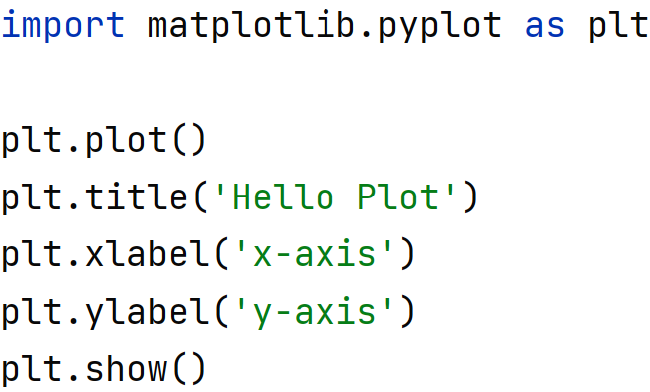
Labeling plots

Slide 7
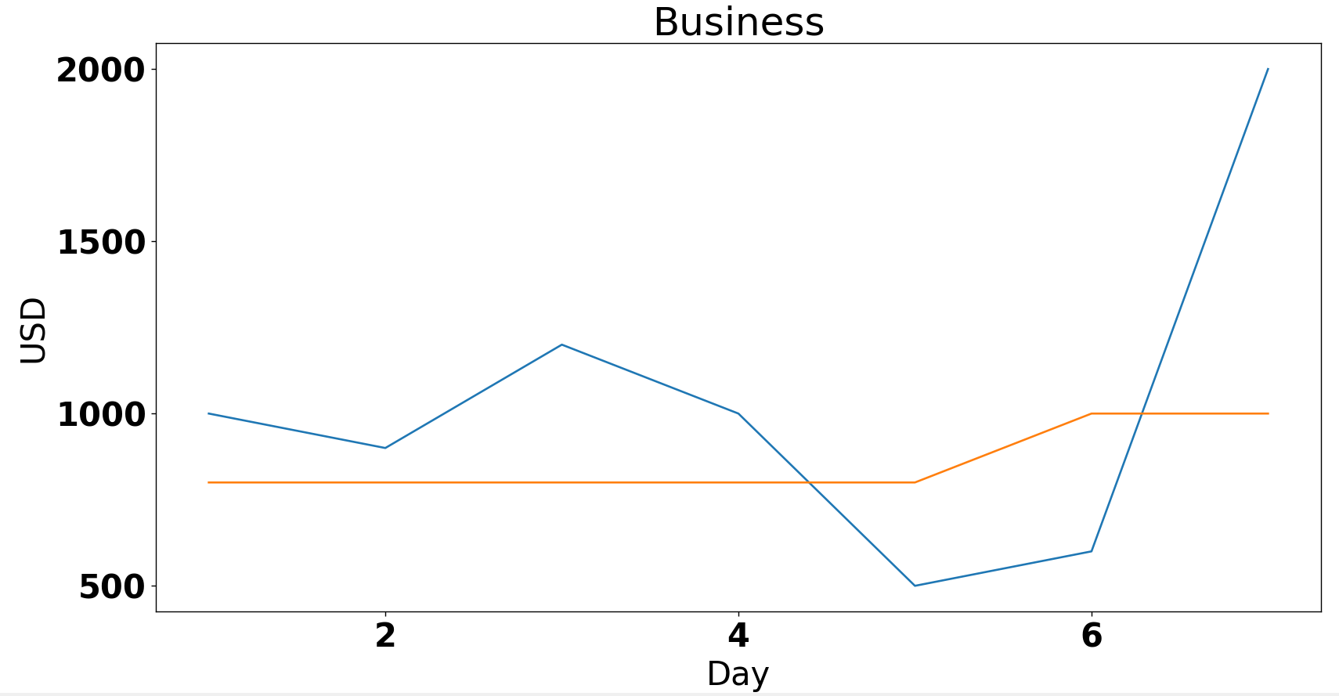
import matplotlib.pyplot as plt import pandas as pd import matplotlib
days = pd.Series([1,2,3,4,5,6,7]) revenue= pd.Series([1000, 900, 1200, 1000,
500, 600, 2000]) expenses = pd.Series([800, 800, 800, 800,
800, 1000, 1000])
plt.plot(days, revenue, label='Revenue') plt.plot(days, expenses, label='Expenses') plt.title('Business') plt.xlabel('Day') plt.ylabel('USD') plt.show()
Creating plots with data

Slide 8
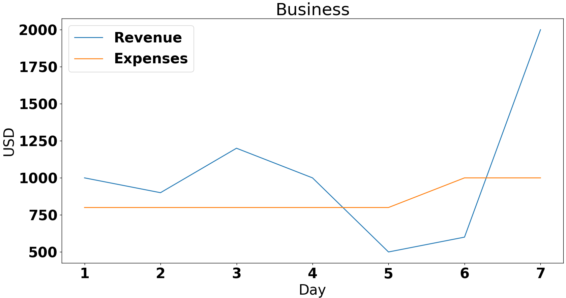
plt.legend()

Slide 9
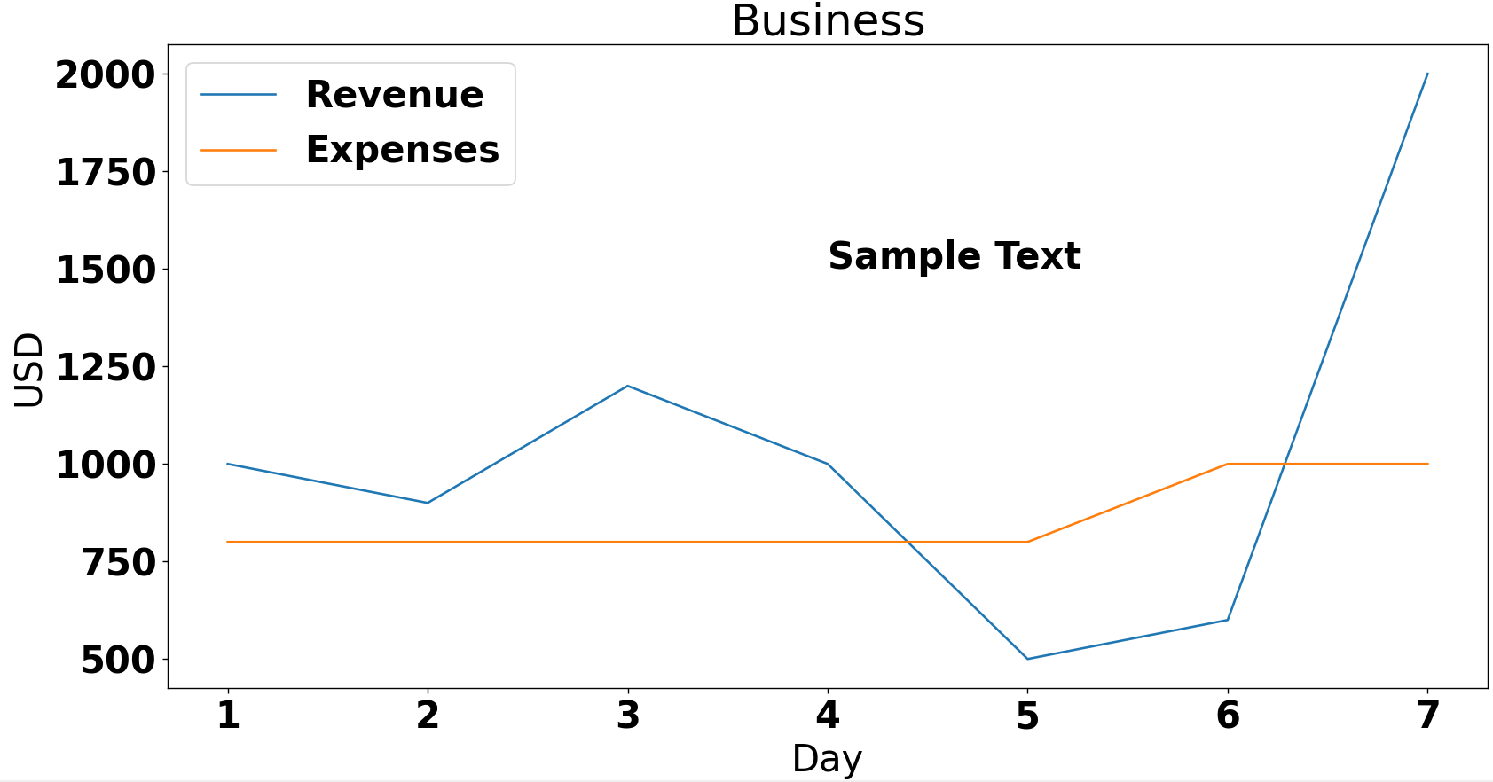
plt.text(4, 1500, ‘Sample Text’)

Slide 10
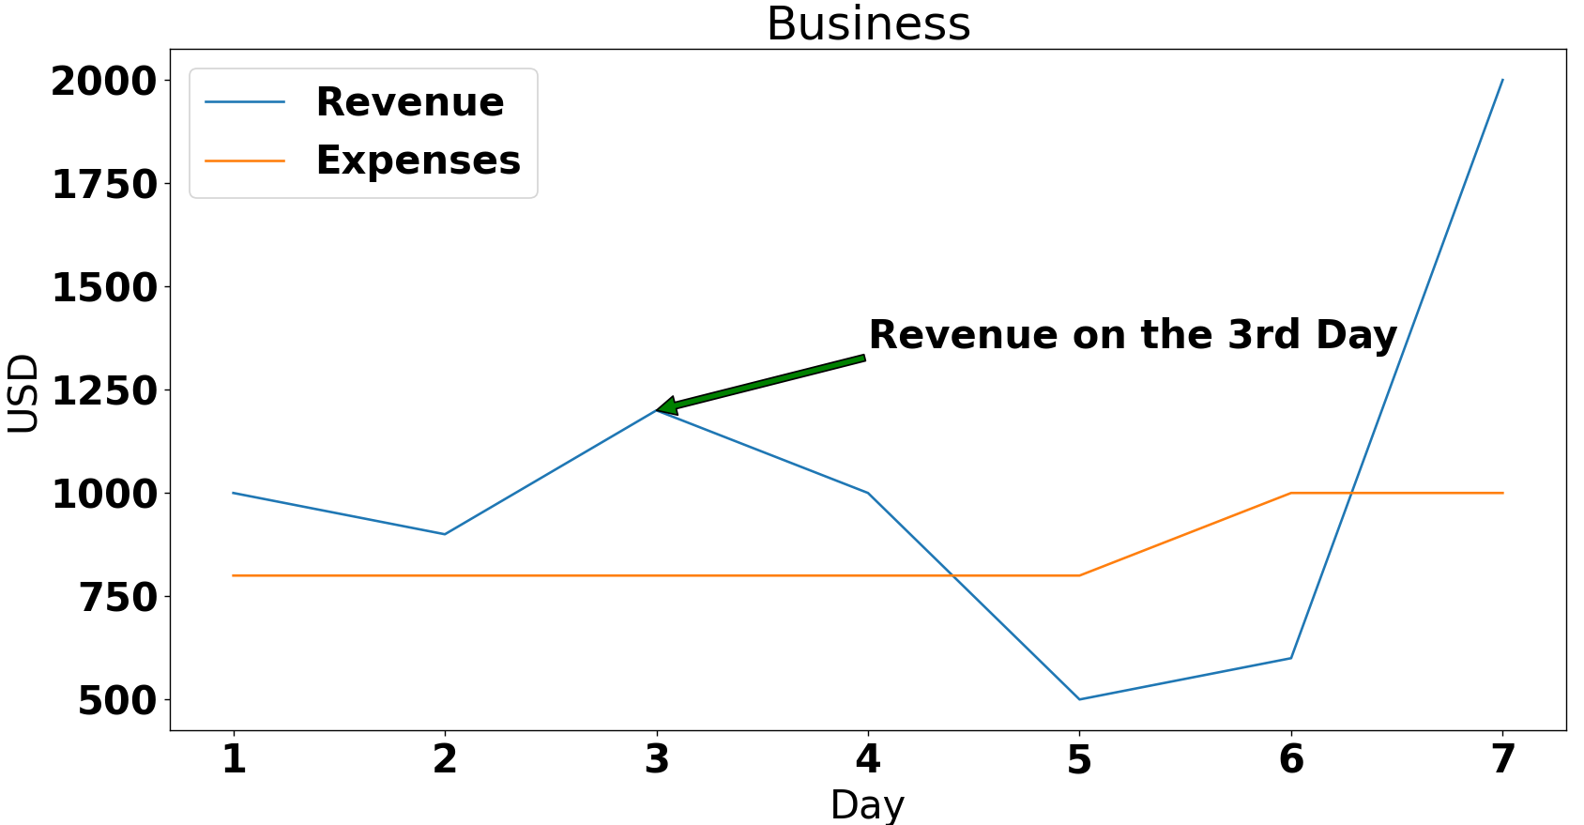
plt.annotate('Revenue on the 3rd Day', arrowprops=dict(facecolor='green'), xy=(3,1200), xytext=(4, 1350))

Slide 11
Changing font size
Using matplotlib Runtime configuration(RC) method:
font = {'family' : 'normal', 'weight' : 'bold', 'size' : 24} matplotlib.rc('font', **font)
Using method parameters:
plt.title('Business', fontsize=20) plt.xlabel('Day', fontsize=20) plt.ylabel('USD', fontsize=20)

Slide 12
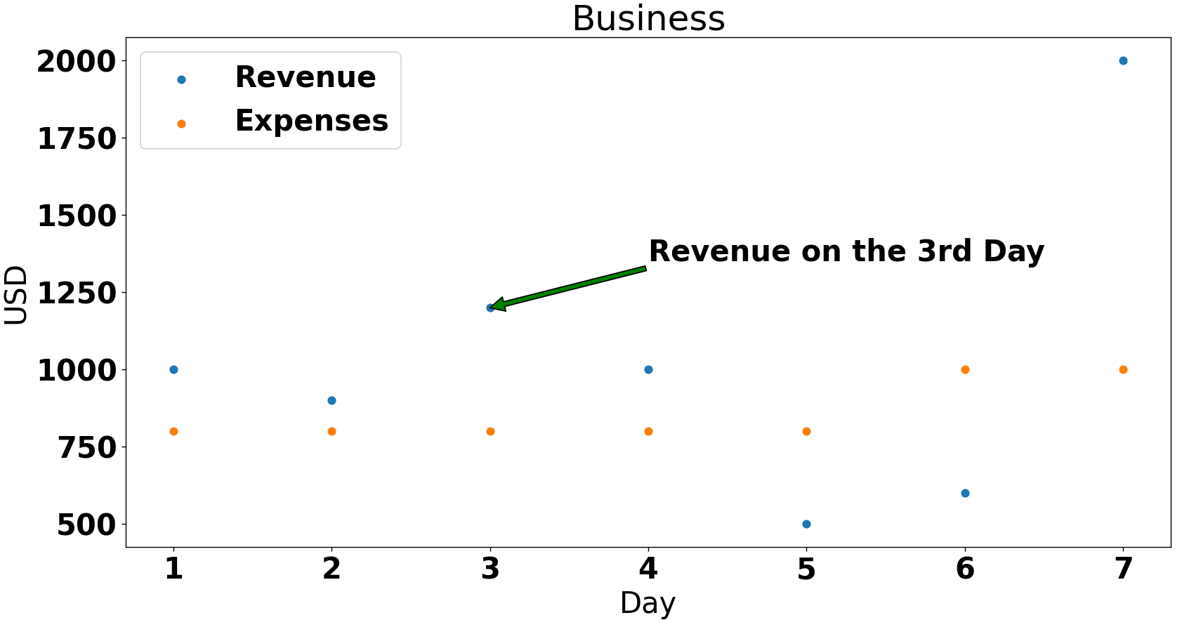
Scatter plot
plt.scatter(days, revenue, label='Revenue') plt.scatter(days, expenses, label='Expenses')

Slide 13
Styling plots
By default, lines and scatter plots are assigned certain colors and style.
The style of different plots can be changed manually:
Line color/style
Marker style

Slide 14
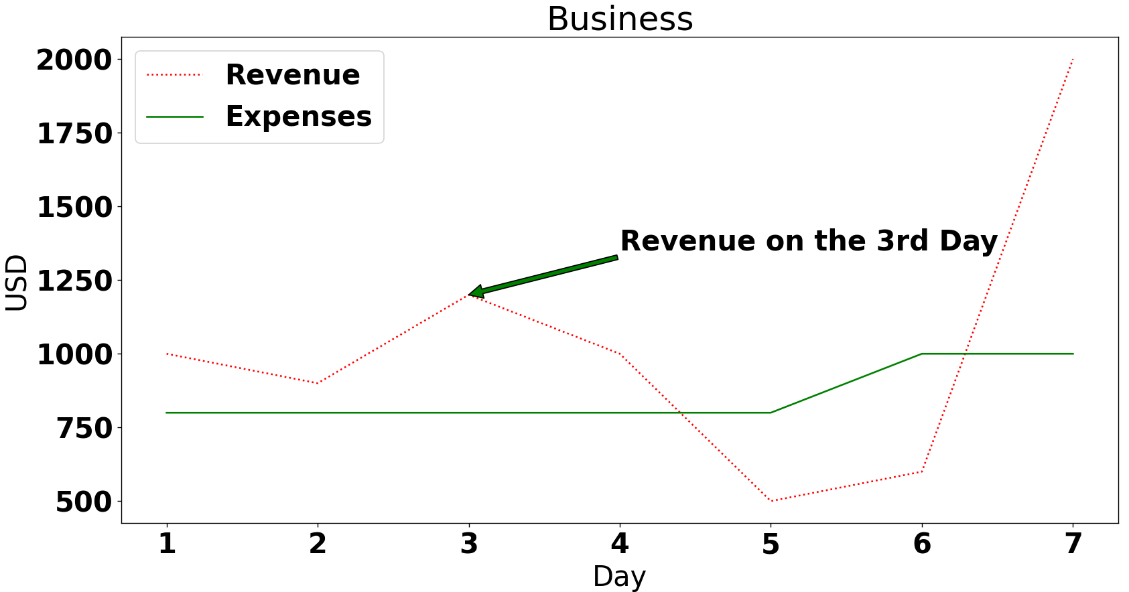
plt.plot(days, revenue, ‘r:’, label='Revenue') plt.plot(days, expenses, 'g-’, label='Expenses')

Slide 15
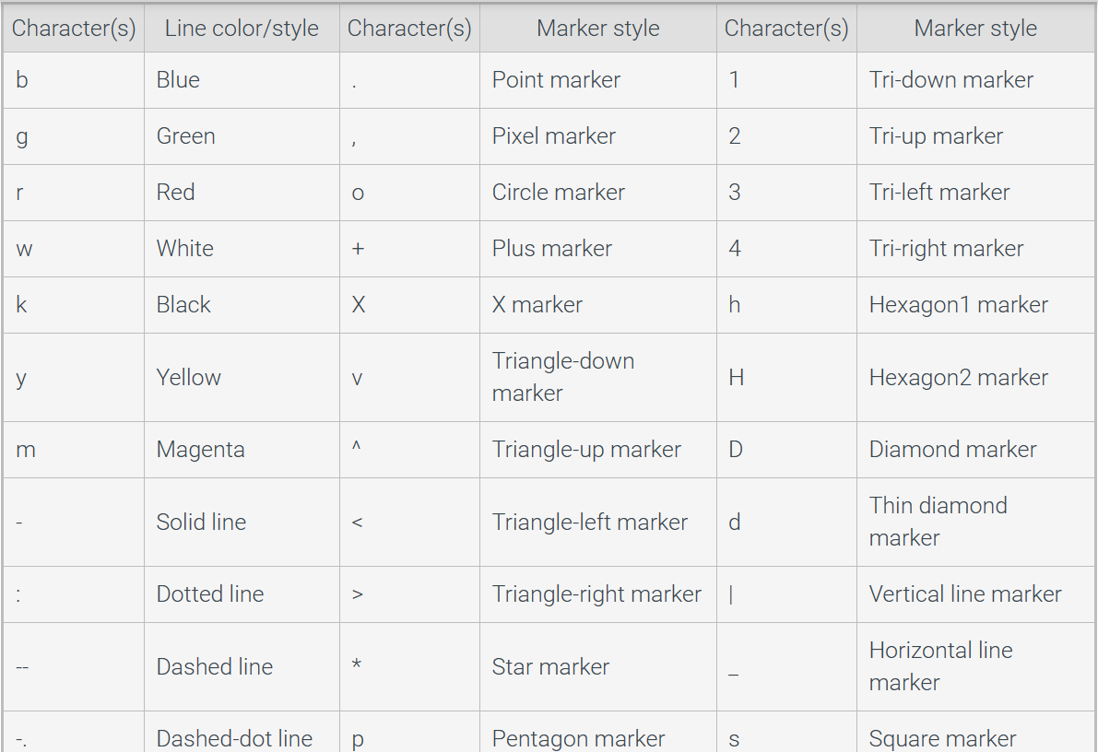

Slide 16
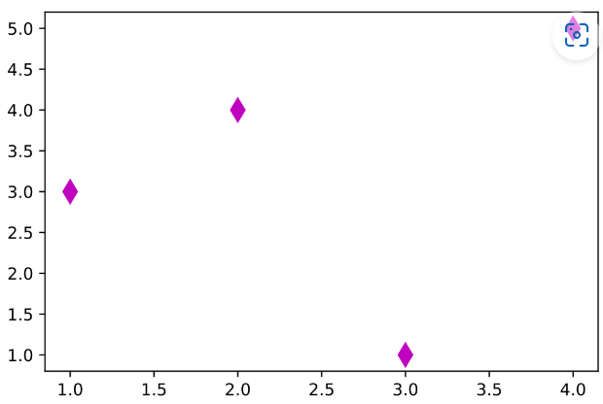
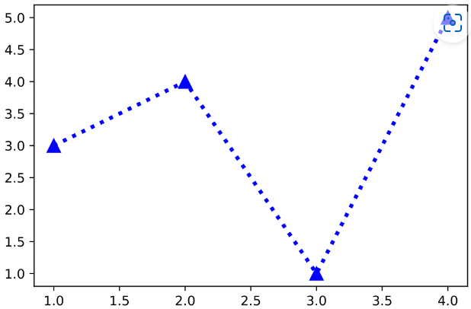
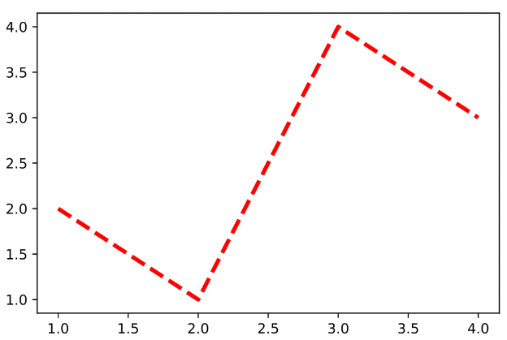
More Examples
‘r--’
‘md’
‘b^:’

Slide 17
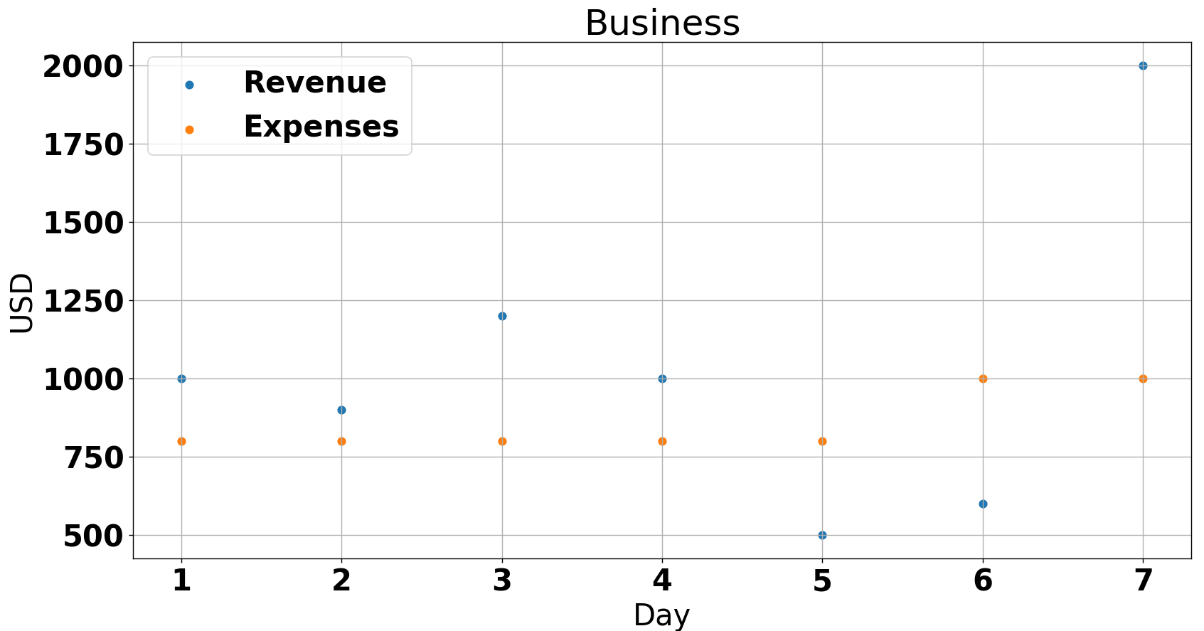
Grid lines
Grid lines are useful when determining the value of a point on a plot
The plt.grid() function adds grid lines to plots
plt.grid()

Slide 18
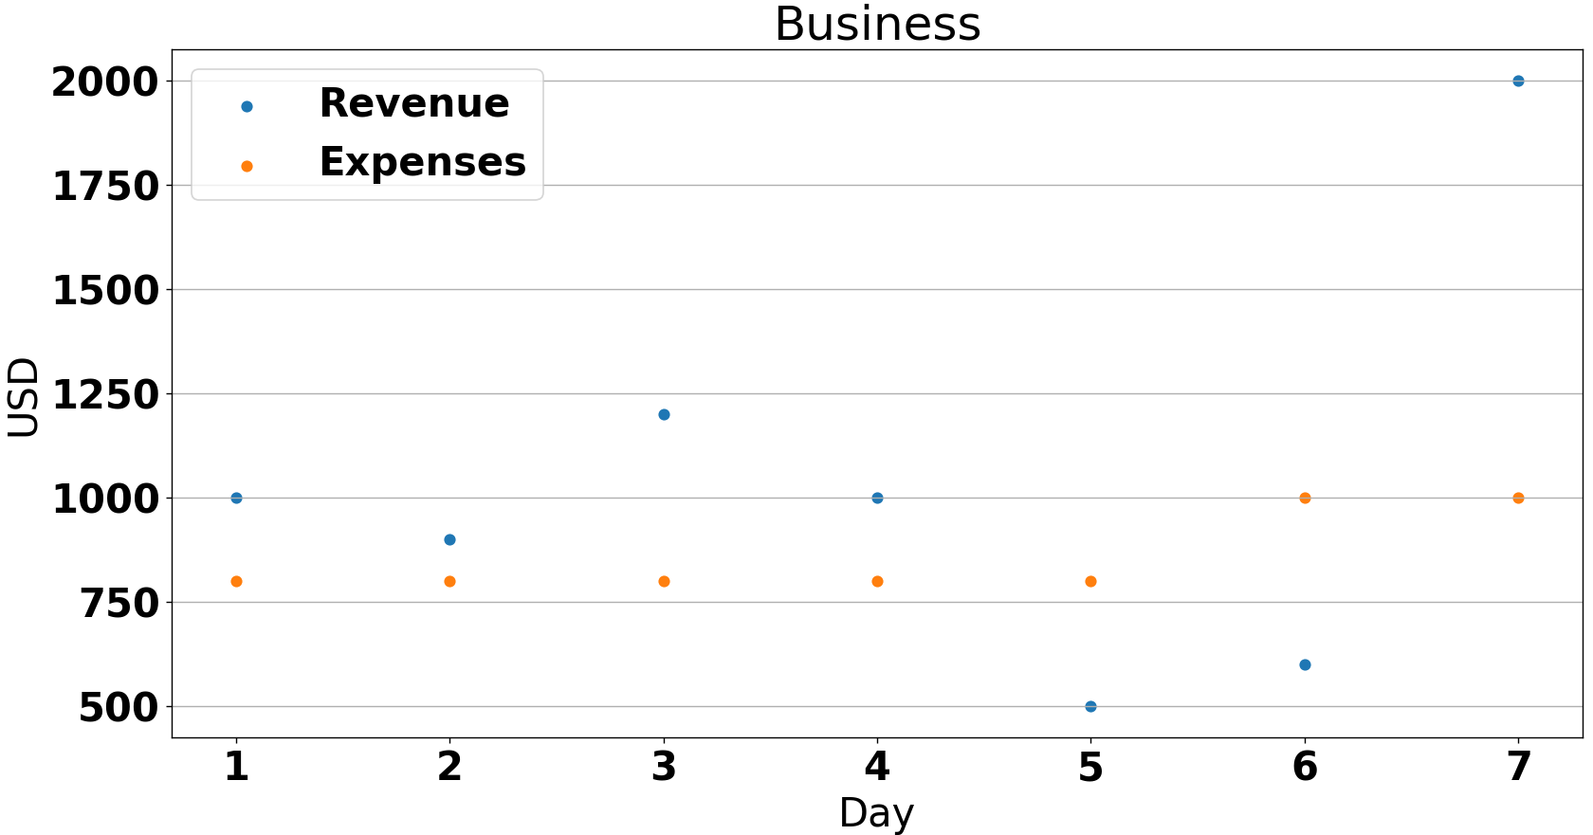
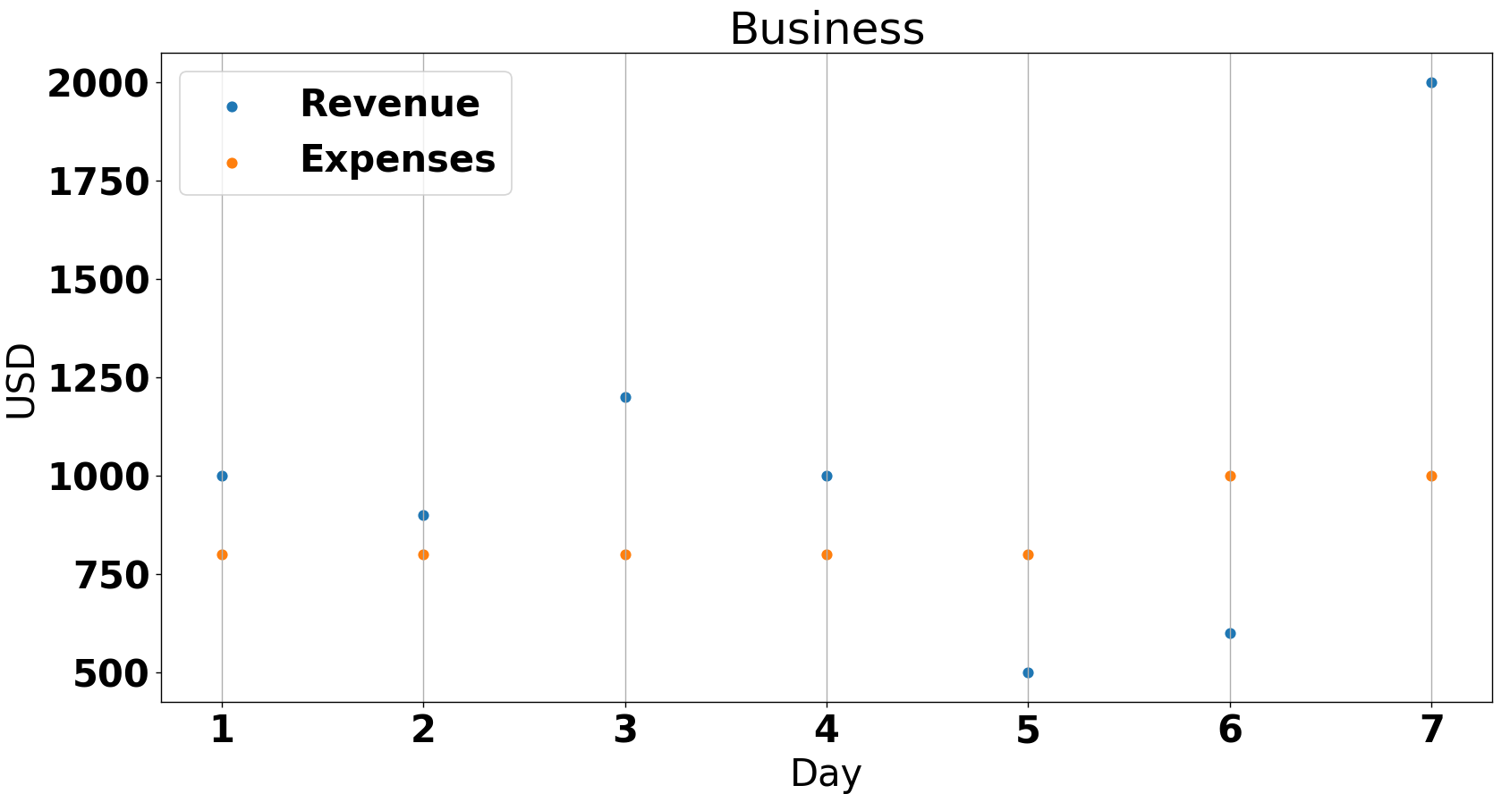
Grid lines
plt.grid(axis='y')
plt.grid(axis=‘x')

Slide 19
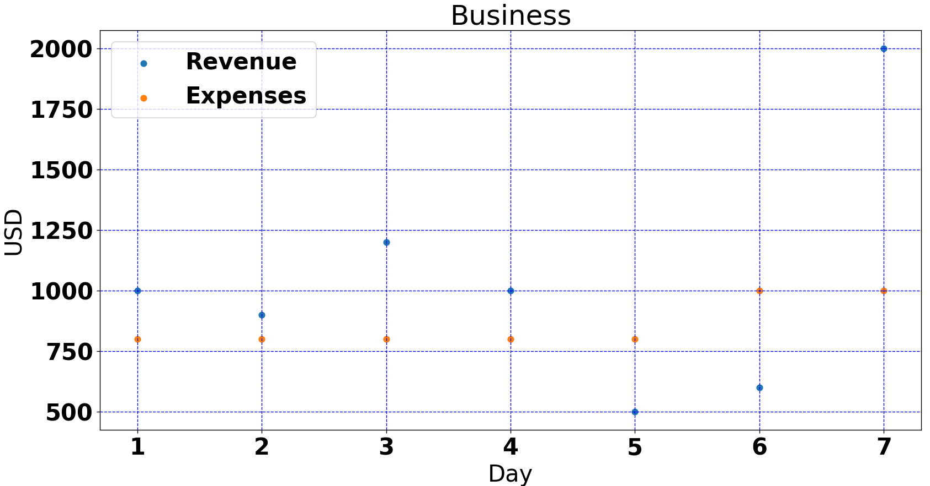
Grid lines
plt.grid(linestyle='--', color='blue')

Slide 20
Multiple Plots
Multiple plots can be drawn in the same figure using the plt.subplot() function
The plt.subplot() function takes three parameters: nrows, ncols, and index
The nrows and ncols parameters specify the figure layout
The index determines which plot is created

Slide 21
Multiple Plots
subplot1
subplot2
subplot1 | subplot2
nrows = 1, ncols = 2, index = 2
nrows = 2, ncols = 1, index = 1
1
2
3
1 | 2
3 | 4
nrows = 2, ncols = 2, index = 3
nrows = 3, ncols = 1, index = 3

Slide 22
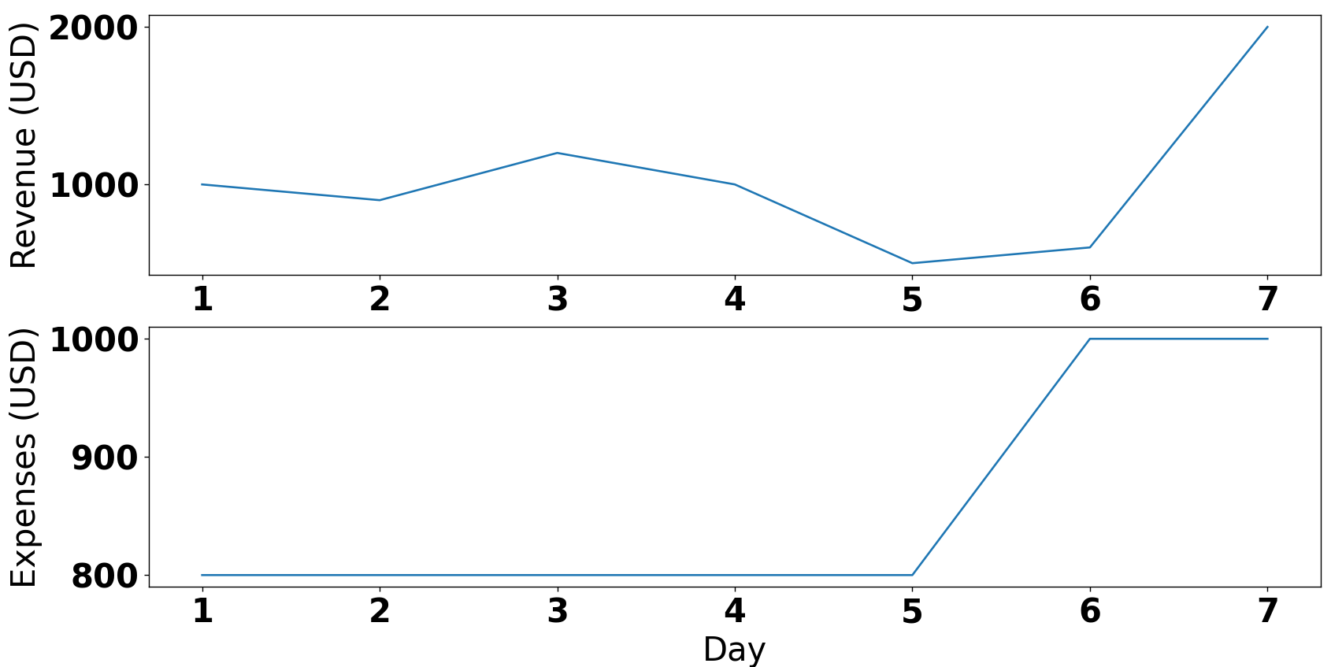
Multiple Plots
plt.subplot(2,1,1) plt.plot(days, revenue,
label='Revenue') plt.ylabel('Revenue (USD)’)
plt.subplot(2,1,2) plt.plot(days, expenses,
label='Expenses') plt.xlabel('Day') plt.ylabel('Expenses (USD)') plt.show()

Slide 23
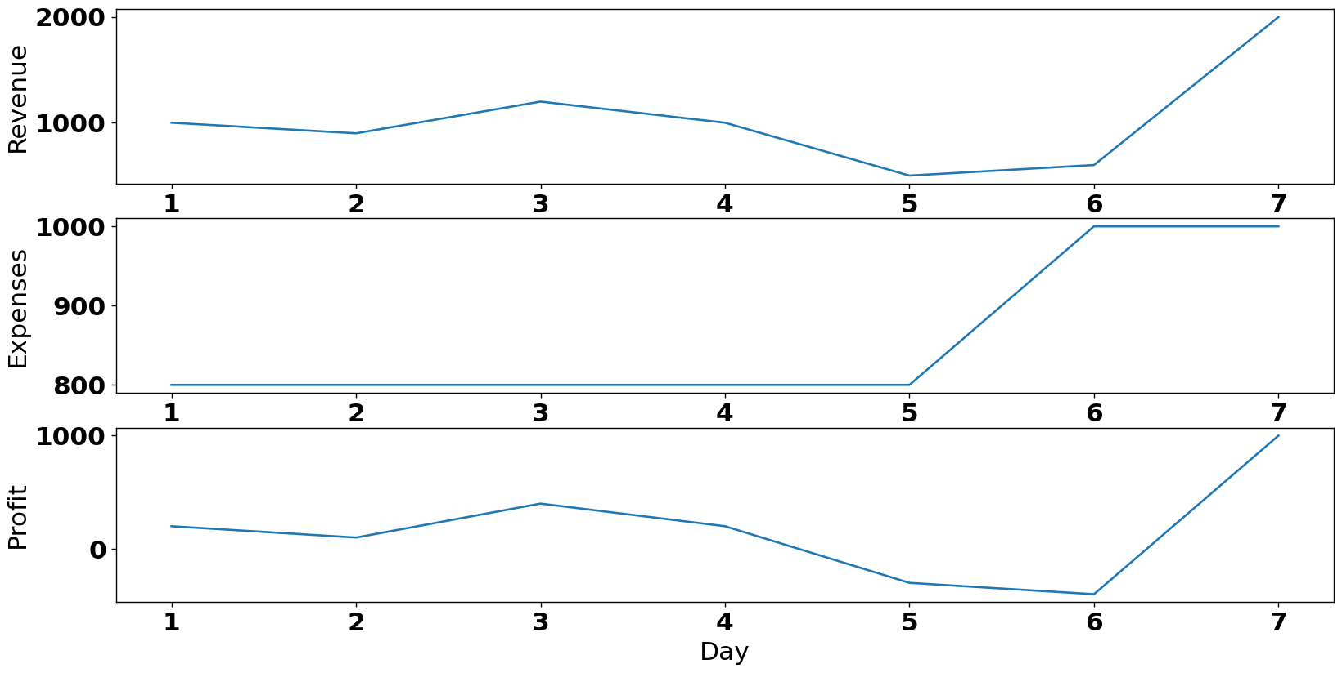
Multiple Plots
plt.subplot(3,1,1) plt.plot(days, revenue,
label='Revenue') plt.ylabel('Revenue') plt.subplot(3,1,2) plt.plot(days, expenses,
label='Expenses') plt.ylabel('Expenses’) plt.subplot(3,1,3) plt.plot(days, revenue-expenses,
label='Net Profit') plt.xlabel('Day') plt.ylabel('Profit') plt.show()

Slide 24
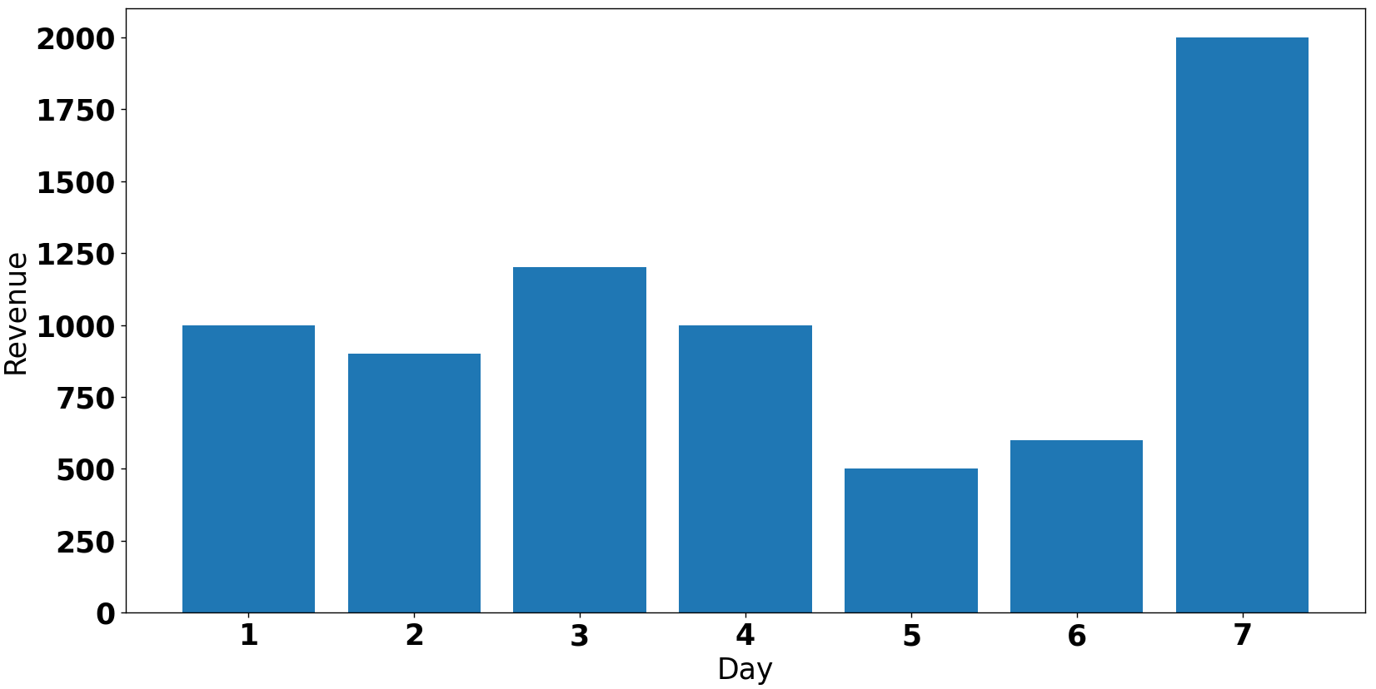
Bar Plot
plt.bar(days, revenue) plt.xlabel('Day') plt.ylabel('Revenue') plt.show()

Slide 25
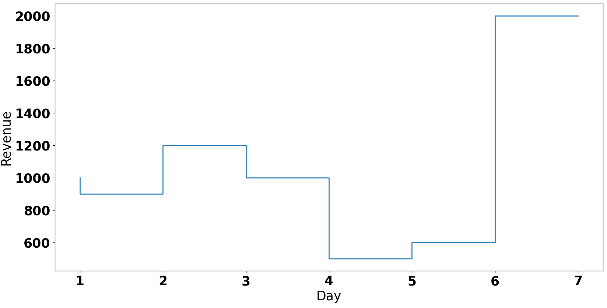
Step Plot
plt.step(days, revenue) plt.xlabel('Day') plt.ylabel('Revenue') plt.show()

Slide 26
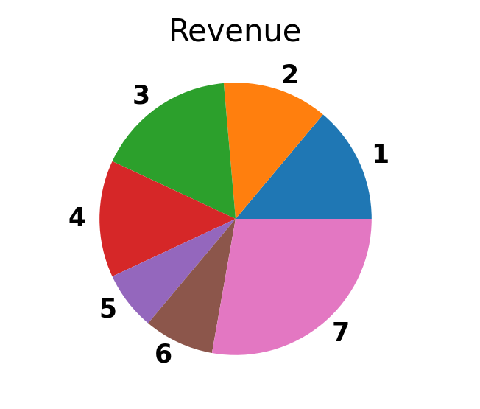
Pie Chart
plt.pie(revenue, labels=days) plt.title('Revenue') plt.show()

Slide 27
Suggested Reading (ZyBook) 31.7 matplotlib package

Slide 28
Attendance

